Slide 1

Pattern Matching Game using FPGA
BY
Team DIGITAL FORTRESS
Team Leader: Rangeet Pan (rpan@uh.edu)
Members: Justin K Augustine (jkaugustine@uh.edu)
Krishna Priya Peddi (kpeddi2@uh.edu)
Naveen Milind Chalawadi (nchalawadi@uh.edu)
Nikhita Singh Satish ( nsatish@uh.edu )

Slide 2

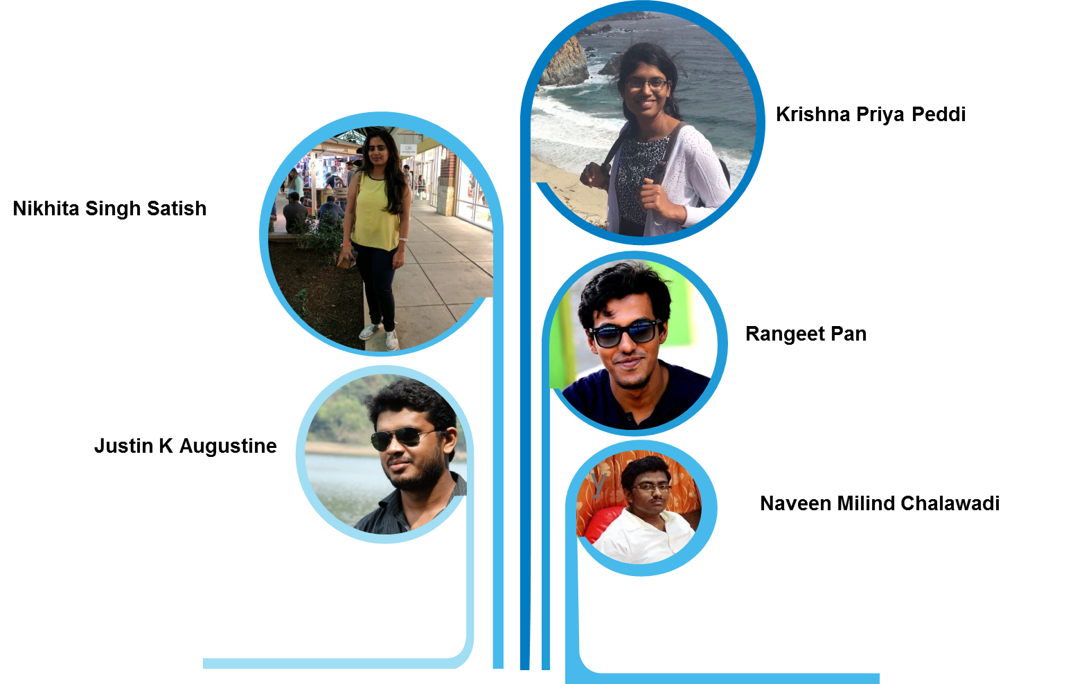
DEVELOPERS
TEAM DIGITAL FORTRESS
”It all started after taking ECE6370. We became a team and our job was to develop an unique and innovative project. We have only one mantra “Work hardest you can and also enjoy those moments”

Slide 3

FEATURES
Reconfigurable Timer and Random Seq Generator
User ID and Password Verification
RAM And ROM
Push buttons/toggle switches/7 segment display
LCD on the DE2 board

Slide 4

Project Description

Slide 5

Project Description
The game can be played by 1 or 2 players
For 1-Player mode
The game generates
A random sequence on a 7-segment display which is the required pattern to score a point and,
another random sequence on 7-segment display and that random sequence moves (Right to Left) from one 7-segment display to its adjacent 7-segment display to reach destination.
The main objective of the player is to is to make certain pattern by input toggle switches such that the combination of randomly generated sequence and their input produces the required pattern.
With every wrong game, a 7-SEG display will be blocked and player cannot use that display in the future.
The game will end when either reaches the highest score or all the seven display has been blocked.
The level of the game is based on the score of the player. As the score increases, the level will automatically increases and the pace with which the display is getting shifted will be faster.

Slide 6
Project Description
For 2-Player mode
In the 2-Player mode, the game will be played just like in 1-Player mode, but it will not random sequence input. The two players will match their inputs to generate the pattern and the player that does it first receives a point. The game will have a timer and the main objective of the players is to score as many points as they.
The game will have # levels. The frequency of the random pattern depends on the score of the player. The frequency keeps increasing with the score i.e increasing the difficulty level of the game for the player.
The game is played with 2 target sequence display for both the players. 3 displays have been chosen for each player and by rotating the display, the game can be played just as the same as the 1-Player game.

Slide 7
Project Description
Authentication
It waits for the enable signal/Start game signal
Player 1 will enter user id starting from the left most digit with the help of push button.
After the user id gets verified, a verification notification will be displayed using a LED notification.
Next process is to provide the password, Password is a mix of character and digit.(i.e. ECE6370).
The game will only start if the user id and password will match, if the Player provides the credentials wrong for 3 times, then s/he will be redirected to the Guest mode and can play the game.
For the 2-Player game, after providing one player’s credentials, other player’s credentials have to entered to authenticate.

Slide 8
Demo

Slide 9
Instruction for the Game

Slide 10

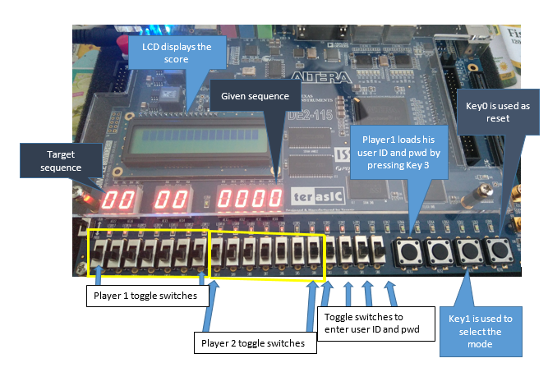
INSTRUCTIONS FOR THE GAME

Slide 11
INSTRUCTIONS FOR THE GAME
Player 1 Mode:
Step 1: User chose the player 1 mode by pushing once the push button Key 1
The reset button is Key0.
Step 2: Provide the authentication by providing the input(SW0-3) and push button Key3. Once you are verified, the game will start.
Step3: The input will be a random sequence.
With every time pulse(which is a level based timer) the input along with the Player input gets to the next box.
User can provide the input using SW11-SW17 toggle switch.
With every correct pattern match, user will be awarded with 1 point.
With the increases of the point, the level of the game will become tougher.
The game timer will run faster.
If the user does provide the correct pattern, after 7 display, the last box will be blocked and user cannot use that in future.
When all the boxes will be blocked or player reaches the max score, which is 20, the game end.
The end of the game will be shown with LED.

Slide 12
INSTRUCTIONS FOR THE GAME
Player 2 Mode:
Step 1: User chose the player 2 mode by pushing twice the push button Key 1
The reset button is Key0.
Step 2: Provide the authentication by providing the input(SW0-3) and push button Key3. Both the players need to verified. Once you are verified, the game will start.
Step3: The input will be a user input.
With every time pulse(which is a level based timer) the input along with the Player input gets to the next box.
User can provide the input using SW11-SW17 toggle switch for Player 2 and SW4-SW10 for player 1.
With every correct pattern match, user will be awarded with 1 point.
With the increases of the point, the level of the game will become tougher.
The game timer will run faster.
If the user does provide the correct pattern, after 7 display, the last box will be blocked and user cannot use that in future.
When all the boxes will be blocked for both the players or any player reaches the max score, which is 20, the game end.
With the end of the game, the winner will be decided based on the score.
The end of the game and winner will be shown with LEDs.

Slide 13
State Diagram & Architecture

Slide 14

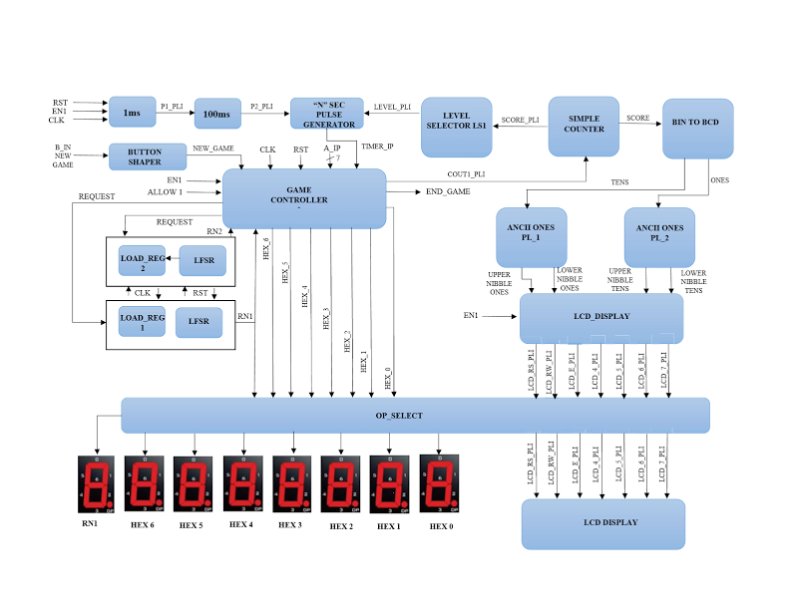
1-Player game Architecture

Slide 15
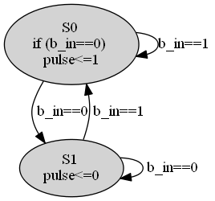
Button Shaper

Slide 16
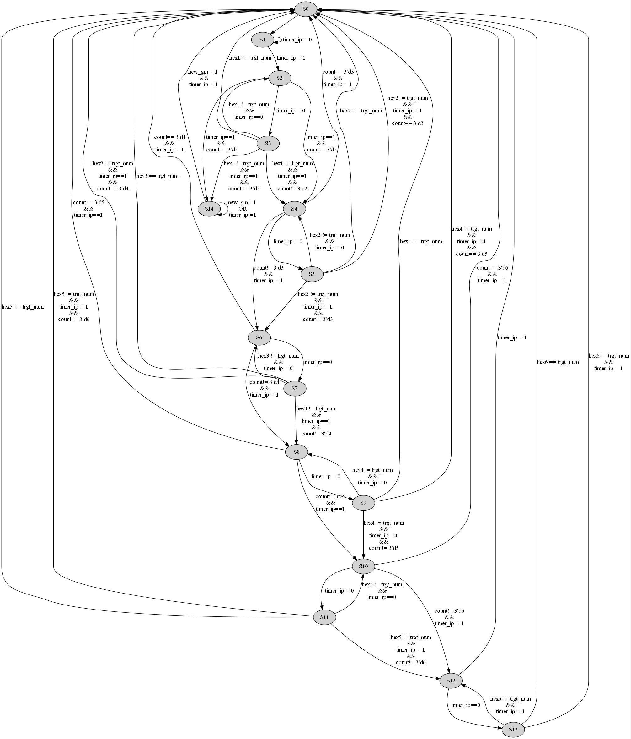
1 Player Game Controller

Slide 17
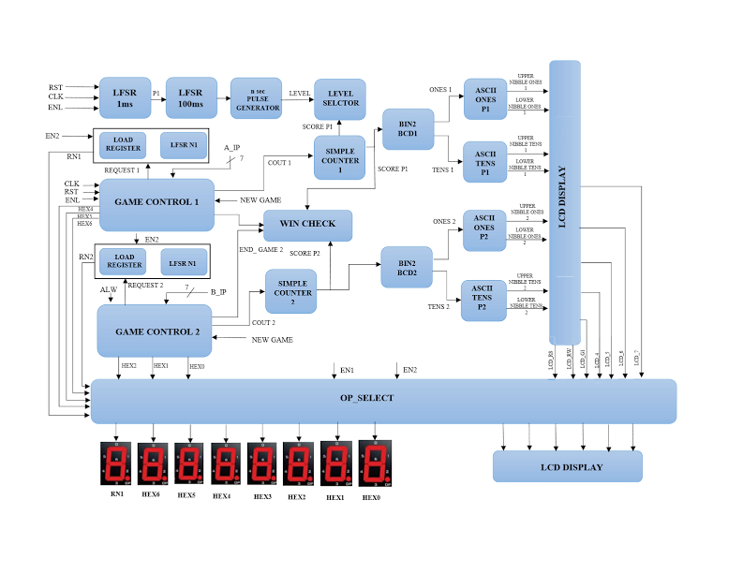
2-Player game Architecture

Slide 18

2 Player Game Controller

Slide 19
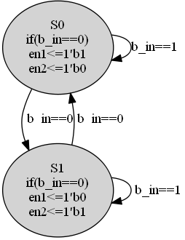
Mode Selector

Slide 20
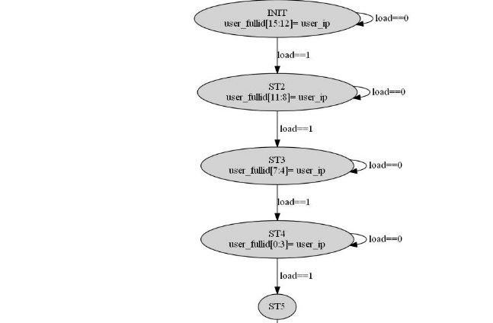
Access Control

Slide 21
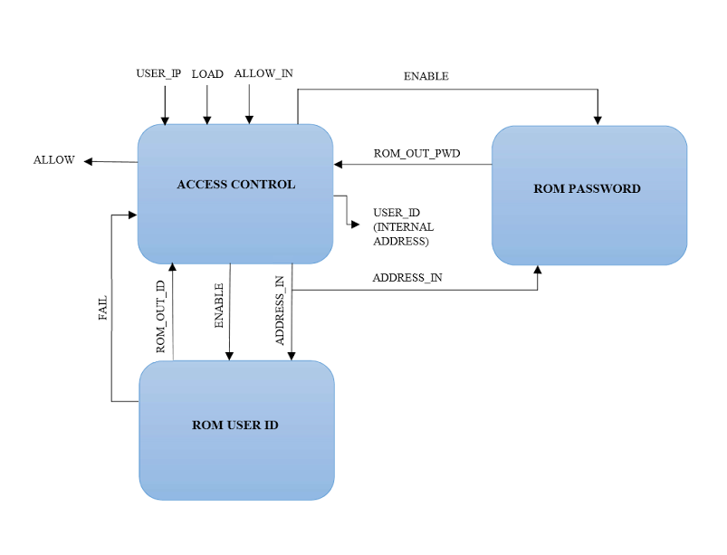
Access Control Architecture

Slide 22
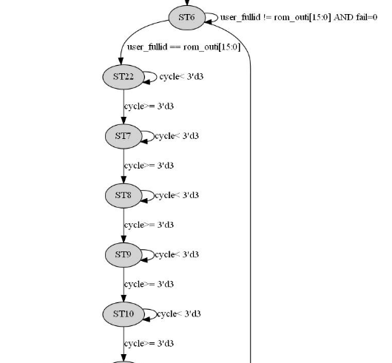
Access Control(contd..)

Slide 23
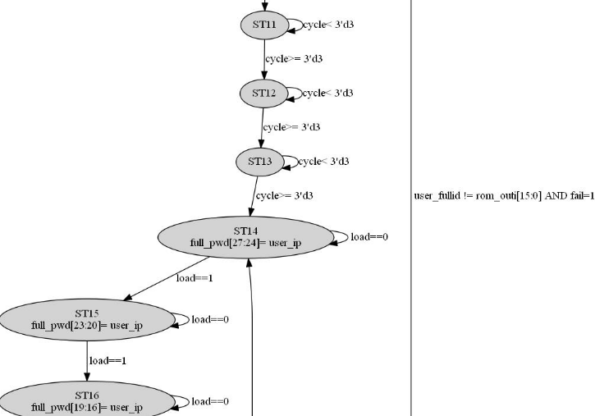
Access Control(contd..)

Slide 24
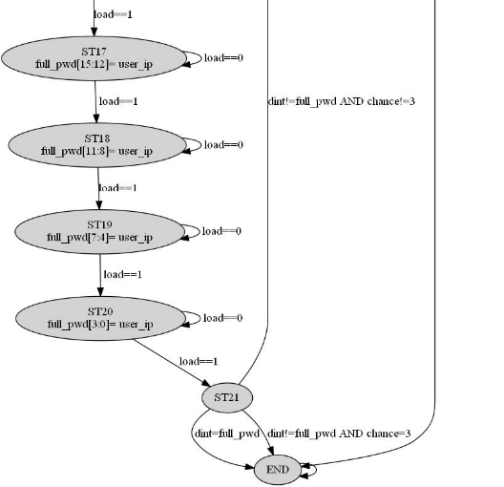
Access Control(contd..)

Slide 25
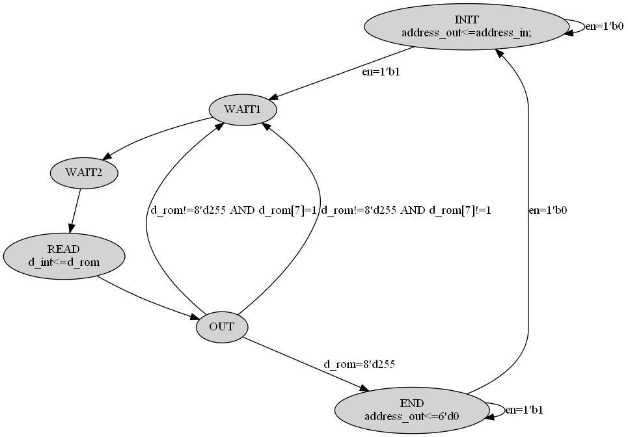
ROM CONTROLLER

Slide 26
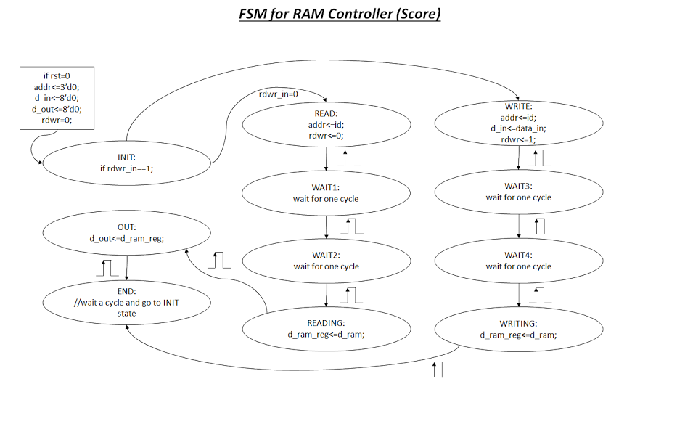
RAM CONTROLLER

Slide 27
What features done!!
RAM and ROM
Authentication of User-id and Password using ROM
Storing/Update scores in RAM
2-Mode Game
Game has 2-modes, 1-Player mode and 2-Player mode. Also guest mode is in the game.
Random Sequence Generator
Random Sequence generator for input and target pattern
Configurable Timer
Timer is configurable based on the score.
LCD Display
Score has been displayed on LCD.
Winner and end game notification
Winner and end game have been notified using LED.

Slide 28
Future improvements.
Improve LCD display.
Live LCD display and game instructions on the display.

Slide 29
Thank You Everyone!
Any questions?

